Slide 1
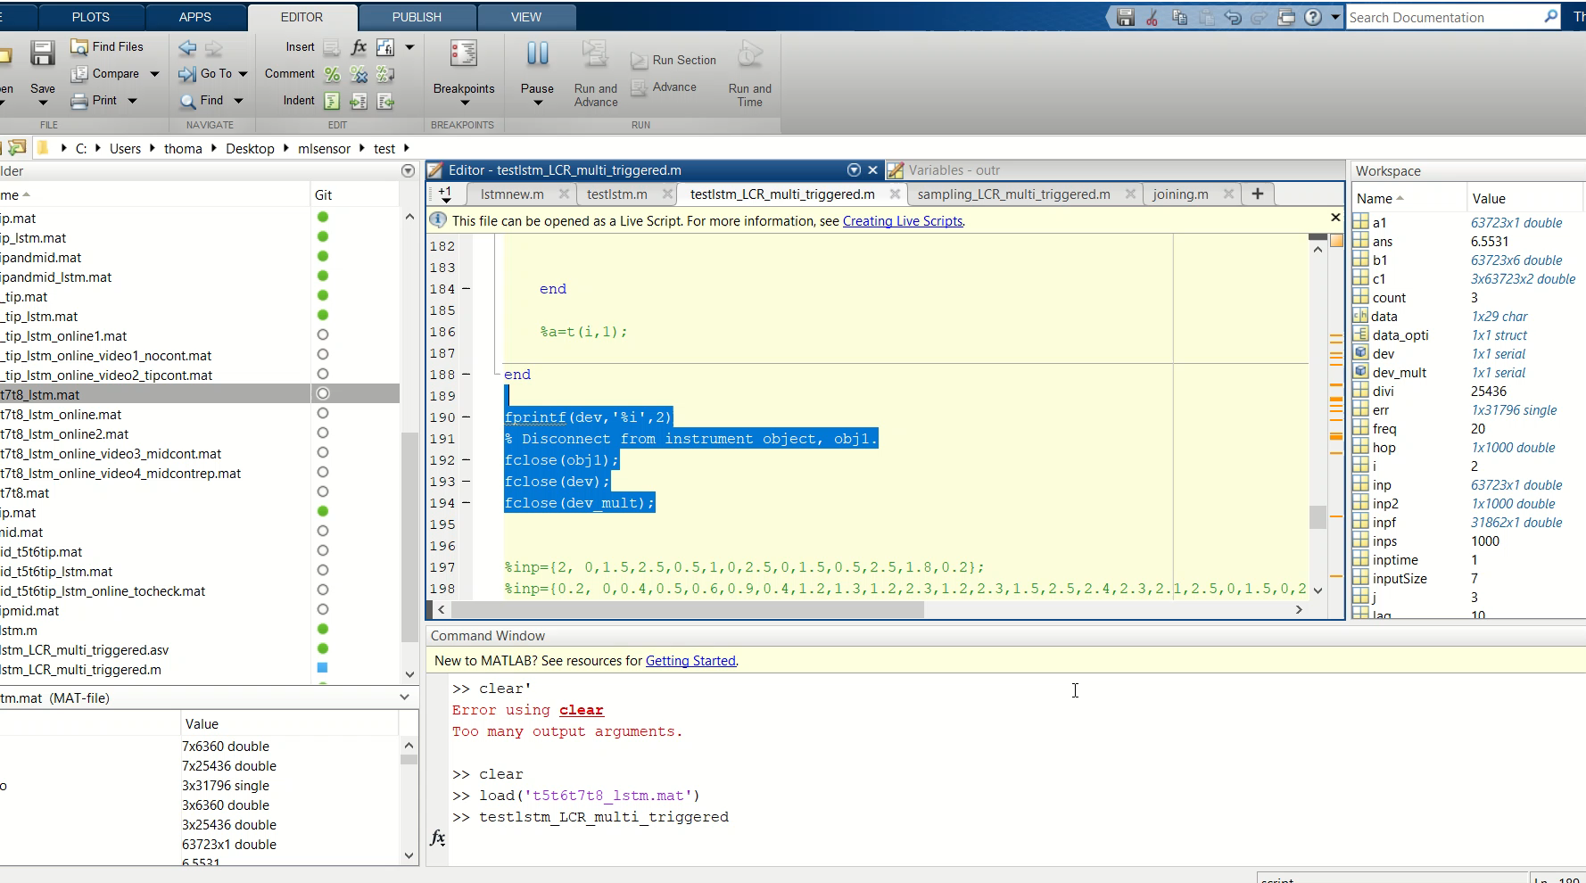
Video 5- I moved the table a lot

